Slide 1
Food Waste and Food Loss
Written and edited by Dr. Keren Dalyot and Yael Rozenblum as a part of the FoodScienceClass project,
The faculty of Education in Science and Technology, Technion
Quiz developed by FoodScienceClass Consortium led by EUFIC

Slide 2

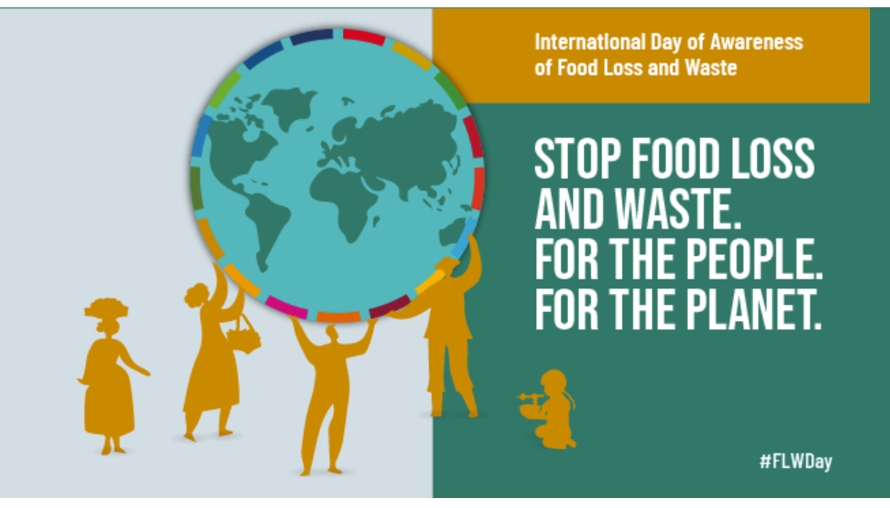
What do you know about Food Waste?

Slide 3
Group Discussion
Next week the parliament will propose a law: creating a national day to prevent wasting food. Can you think about policies the parliament can propose during that day?

Slide 4
Do You or Your Family Members Throw Food Away?
Never
Sometimes, mostly leftovers from meals or parts that we have no use for, like potato peels
Constantly, leftovers from meals, expired or spoiled products, food that was not eaten and so on

Slide 5
Food Loss Vs. Food Waste Definitions
All the crop and livestock human-edible commodity quantities that completely exit the post-harvest/ slaughter production/supply chain by being discarded before reaching the retail level
Food and associated inedible parts from either the manufacturing, retail, and household sectors that is essentially thrown away

Slide 6
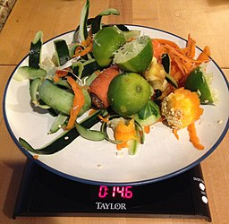
How Much Food is Lost and Wasted Globally Every Year?
20%
Food loss in Europe per year
—--amount to—--
About 88 million tons a year
30%
Food loss in the world per year
—--amount to—--
About 1.3 million tons a year
Data from: ttps://ec.europa.eu/food/safety/food-waste_en#:~:text=Related%20links-,About%20Food%20Waste,day%20(Eurostat%2C%202020).
Image credit: https://commons.wikimedia.org/wiki/File:Consumer_Food_Waste.JPG

Slide 7
Data - How much Food is Lost in our country every Year?
XX%
Food loss in COUNTRY per year
—--amounts to—--
About xx million tons a year

Slide 8
Why Should We Care?
Economy: saving in costs of production, purchasing and more

Slide 9
Why Should We Care?
Economy: saving in costs of production, purchasing and more
Social: assistance to the disadvantaged groups and reducing the gaps between all social classes

Slide 10
Why Should We Care?
Economy: saving in costs of production, purchasing and more
Social: assistance to the disadvantaged groups and reducing the gaps between all social classes
Environment: reducing the amount of pollutants, greenhouse gases, and global warming

Slide 11

Kahoot Challenge - What do you know about food waste and food safety?

Slide 12
Quiz time - What do you know about food waste and food safety?

Slide 13
1. Which section of the refrigerator is the warmest?
Door
Bottom drawers
Top shelf
Freezer

Slide 14
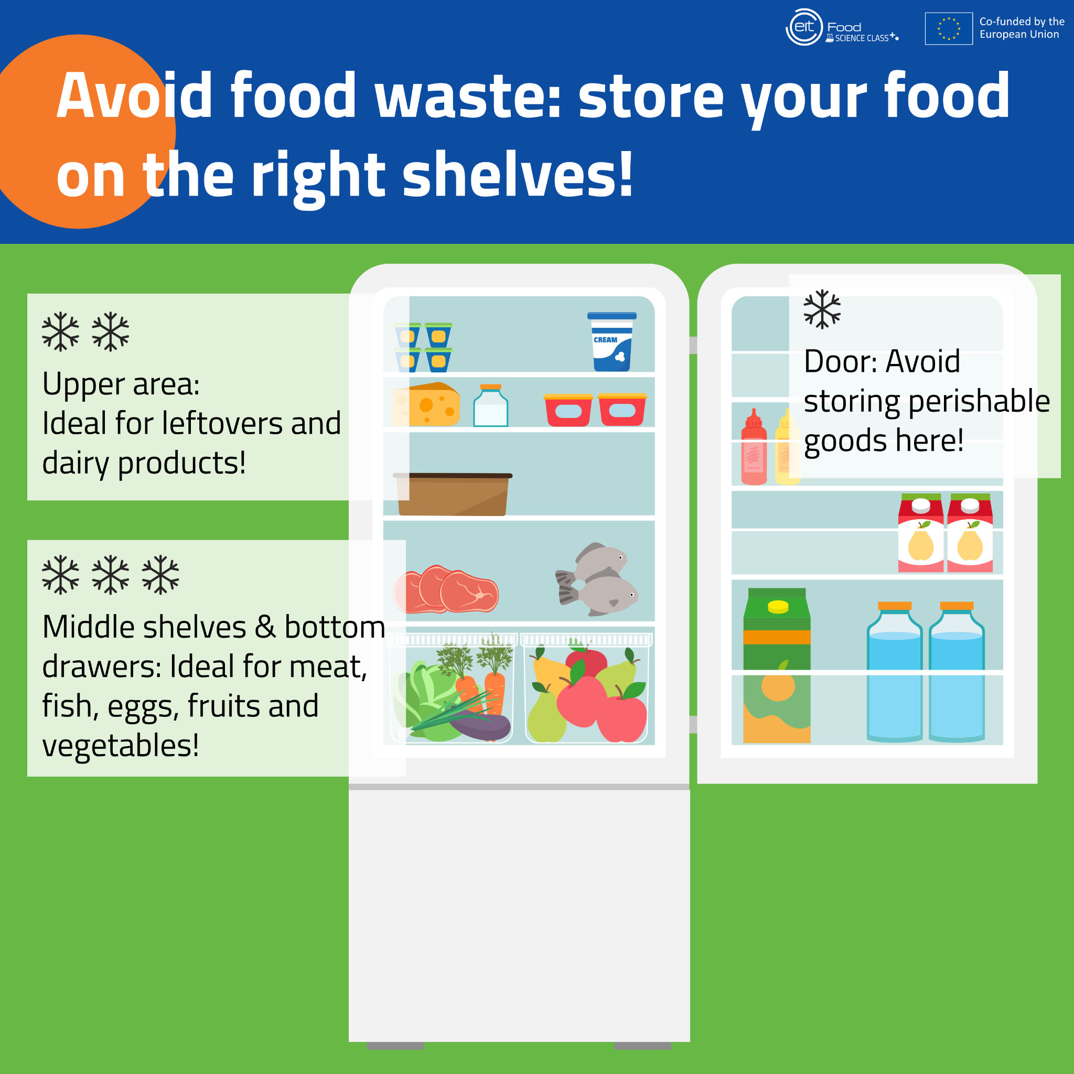
The door is the warmest part of the fridge and the most prone to temperatures changes, so it’s the best place to store products with a long shelf life like sauces (mayonnaise, mustard, etc) and bottled drinks.

Slide 15
2. When the “best before” date on a food package has expired, you should throw the product away?
True 2. False

Slide 16
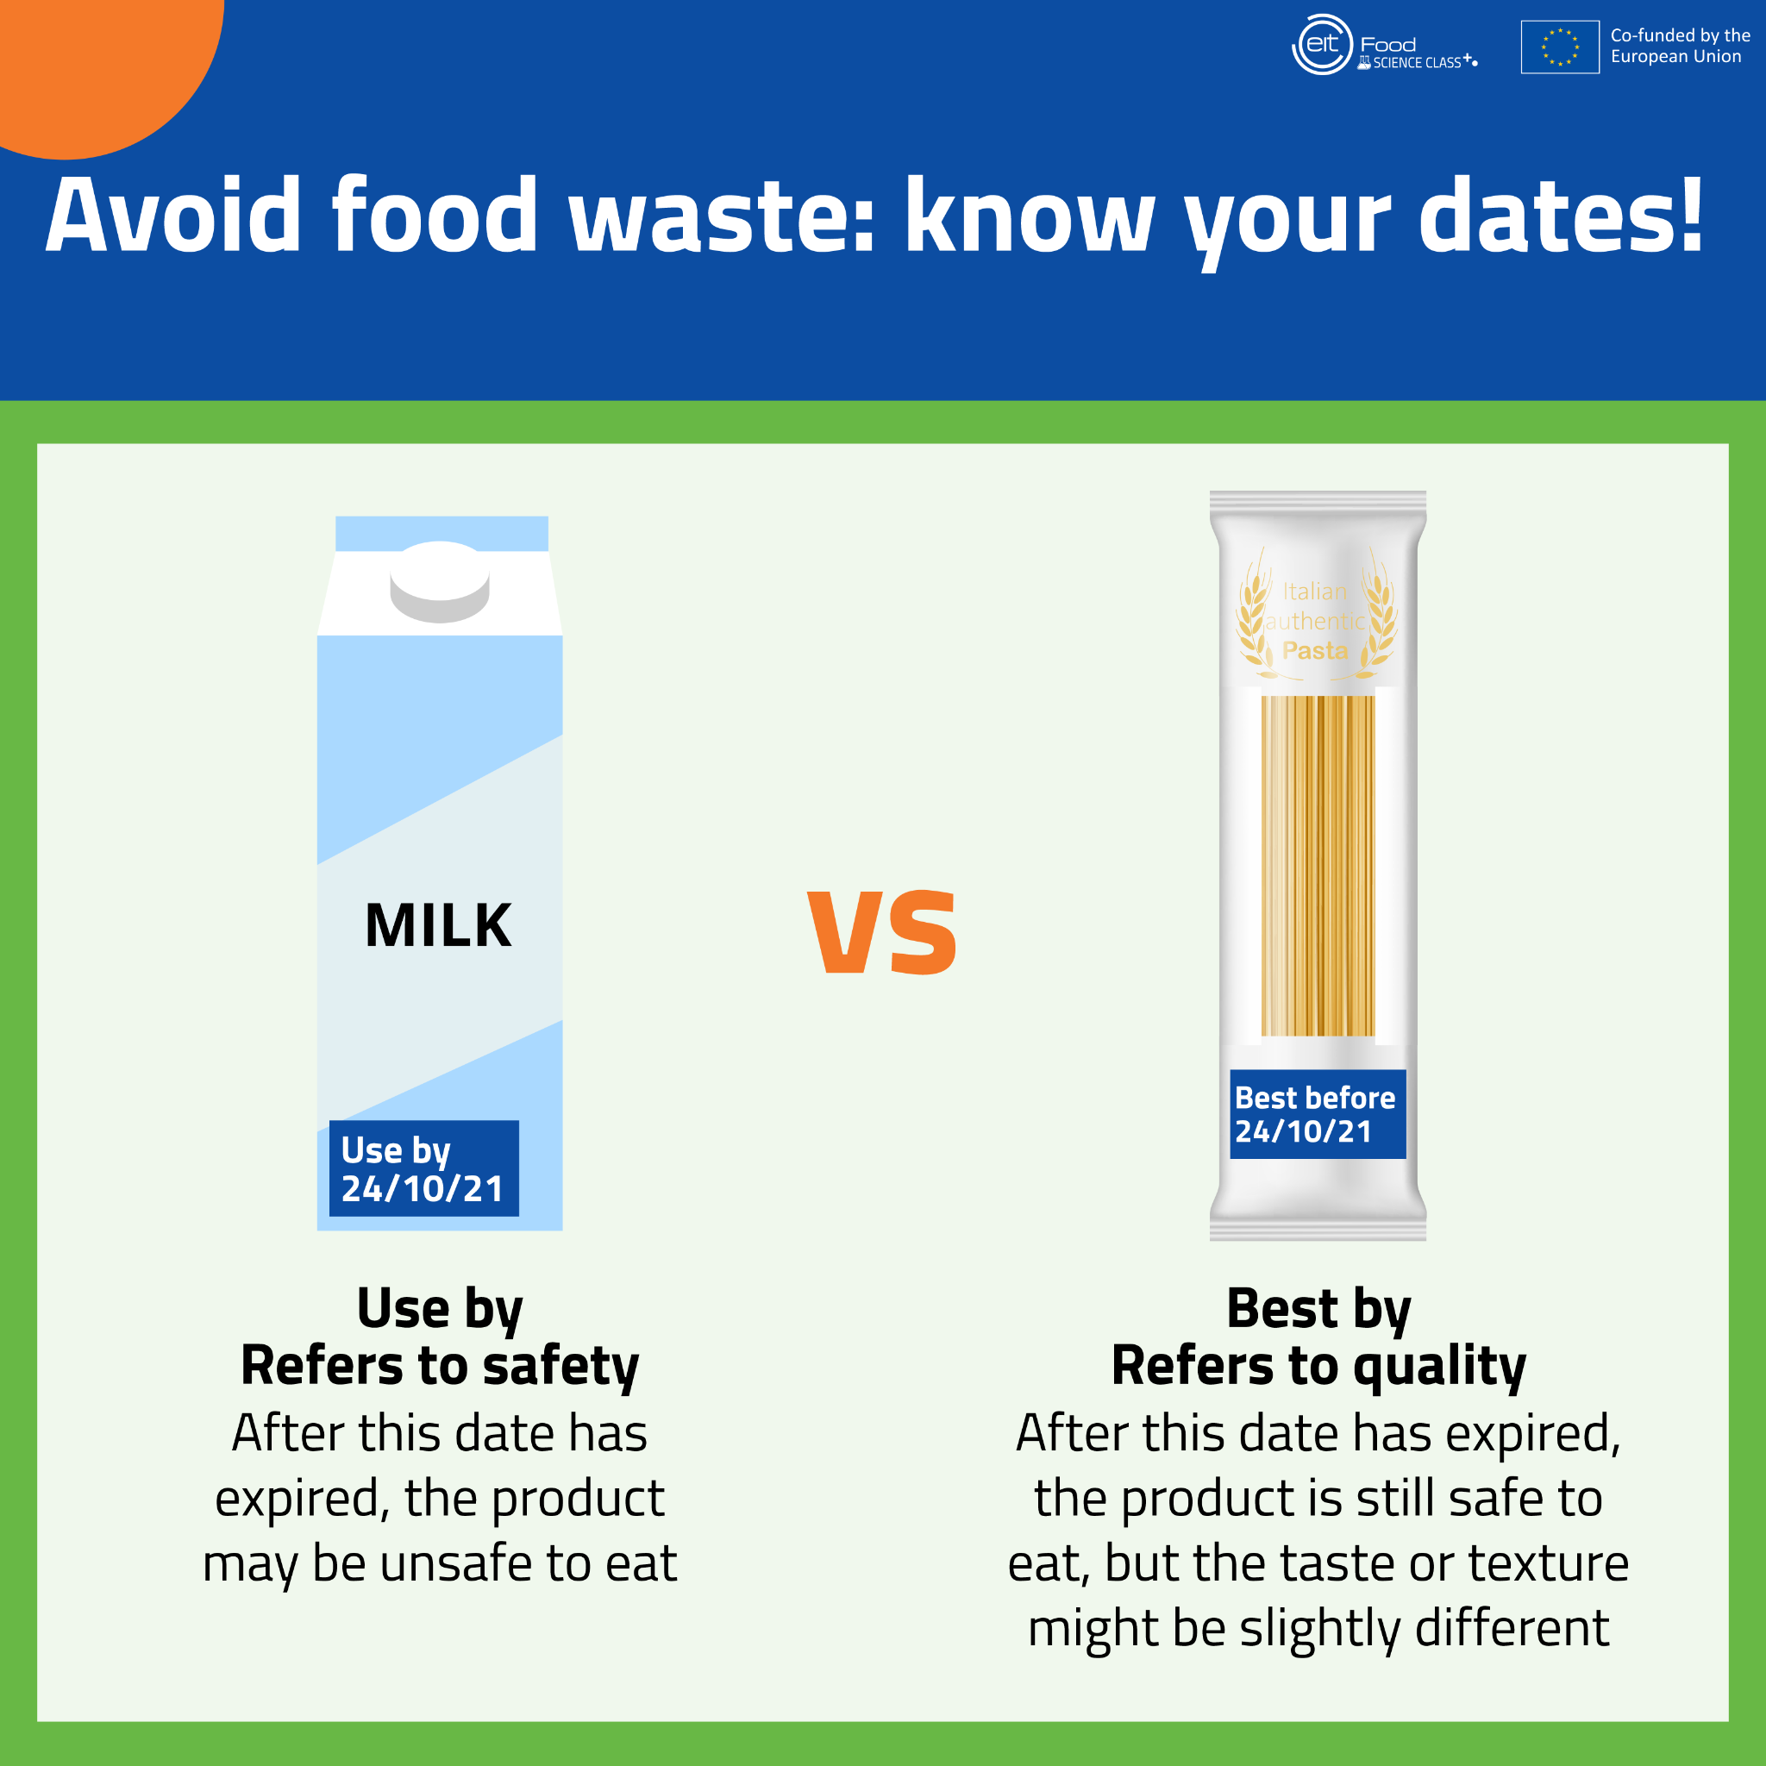
“Best before” date refers to the quality of foods: it means that the food is still safe to eat past that date, but the taste or texture may be slightly different.
“Use by” date refers to the safety of foods: it means that the food may no longer be safe to eat past that date, even if it looks or smells fine.

Slide 17
3. Where does the largest proportion of food waste come from worldwide?
Restaurants
Households
Grocery stores
Farms

Slide 18
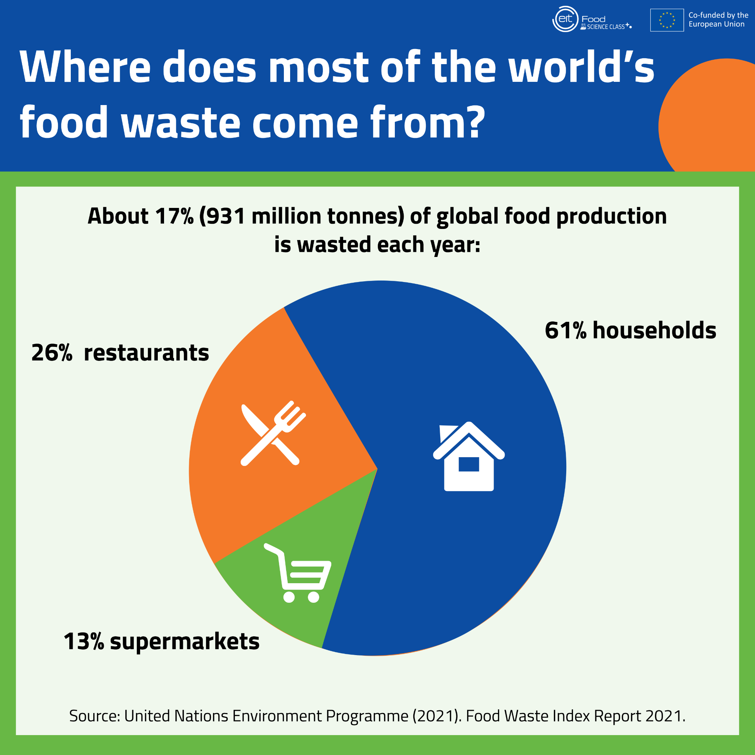
On average, each person wastes between 76 and 91 kilogram of food per year – an equivalent of 1000 portions of cooked pasta in just a year! Most food waste comes from households (61%), followed by restaurants (26%) and supermarkets (13%).

Slide 19
4. How can we buy smarter and avoid food waste?
Buy loose fruits & vegetables rather than pre-packaged
Write a shopping list and stick to it
Ignore deals on products that lead us to buy more than we need
All of the above

Slide 20
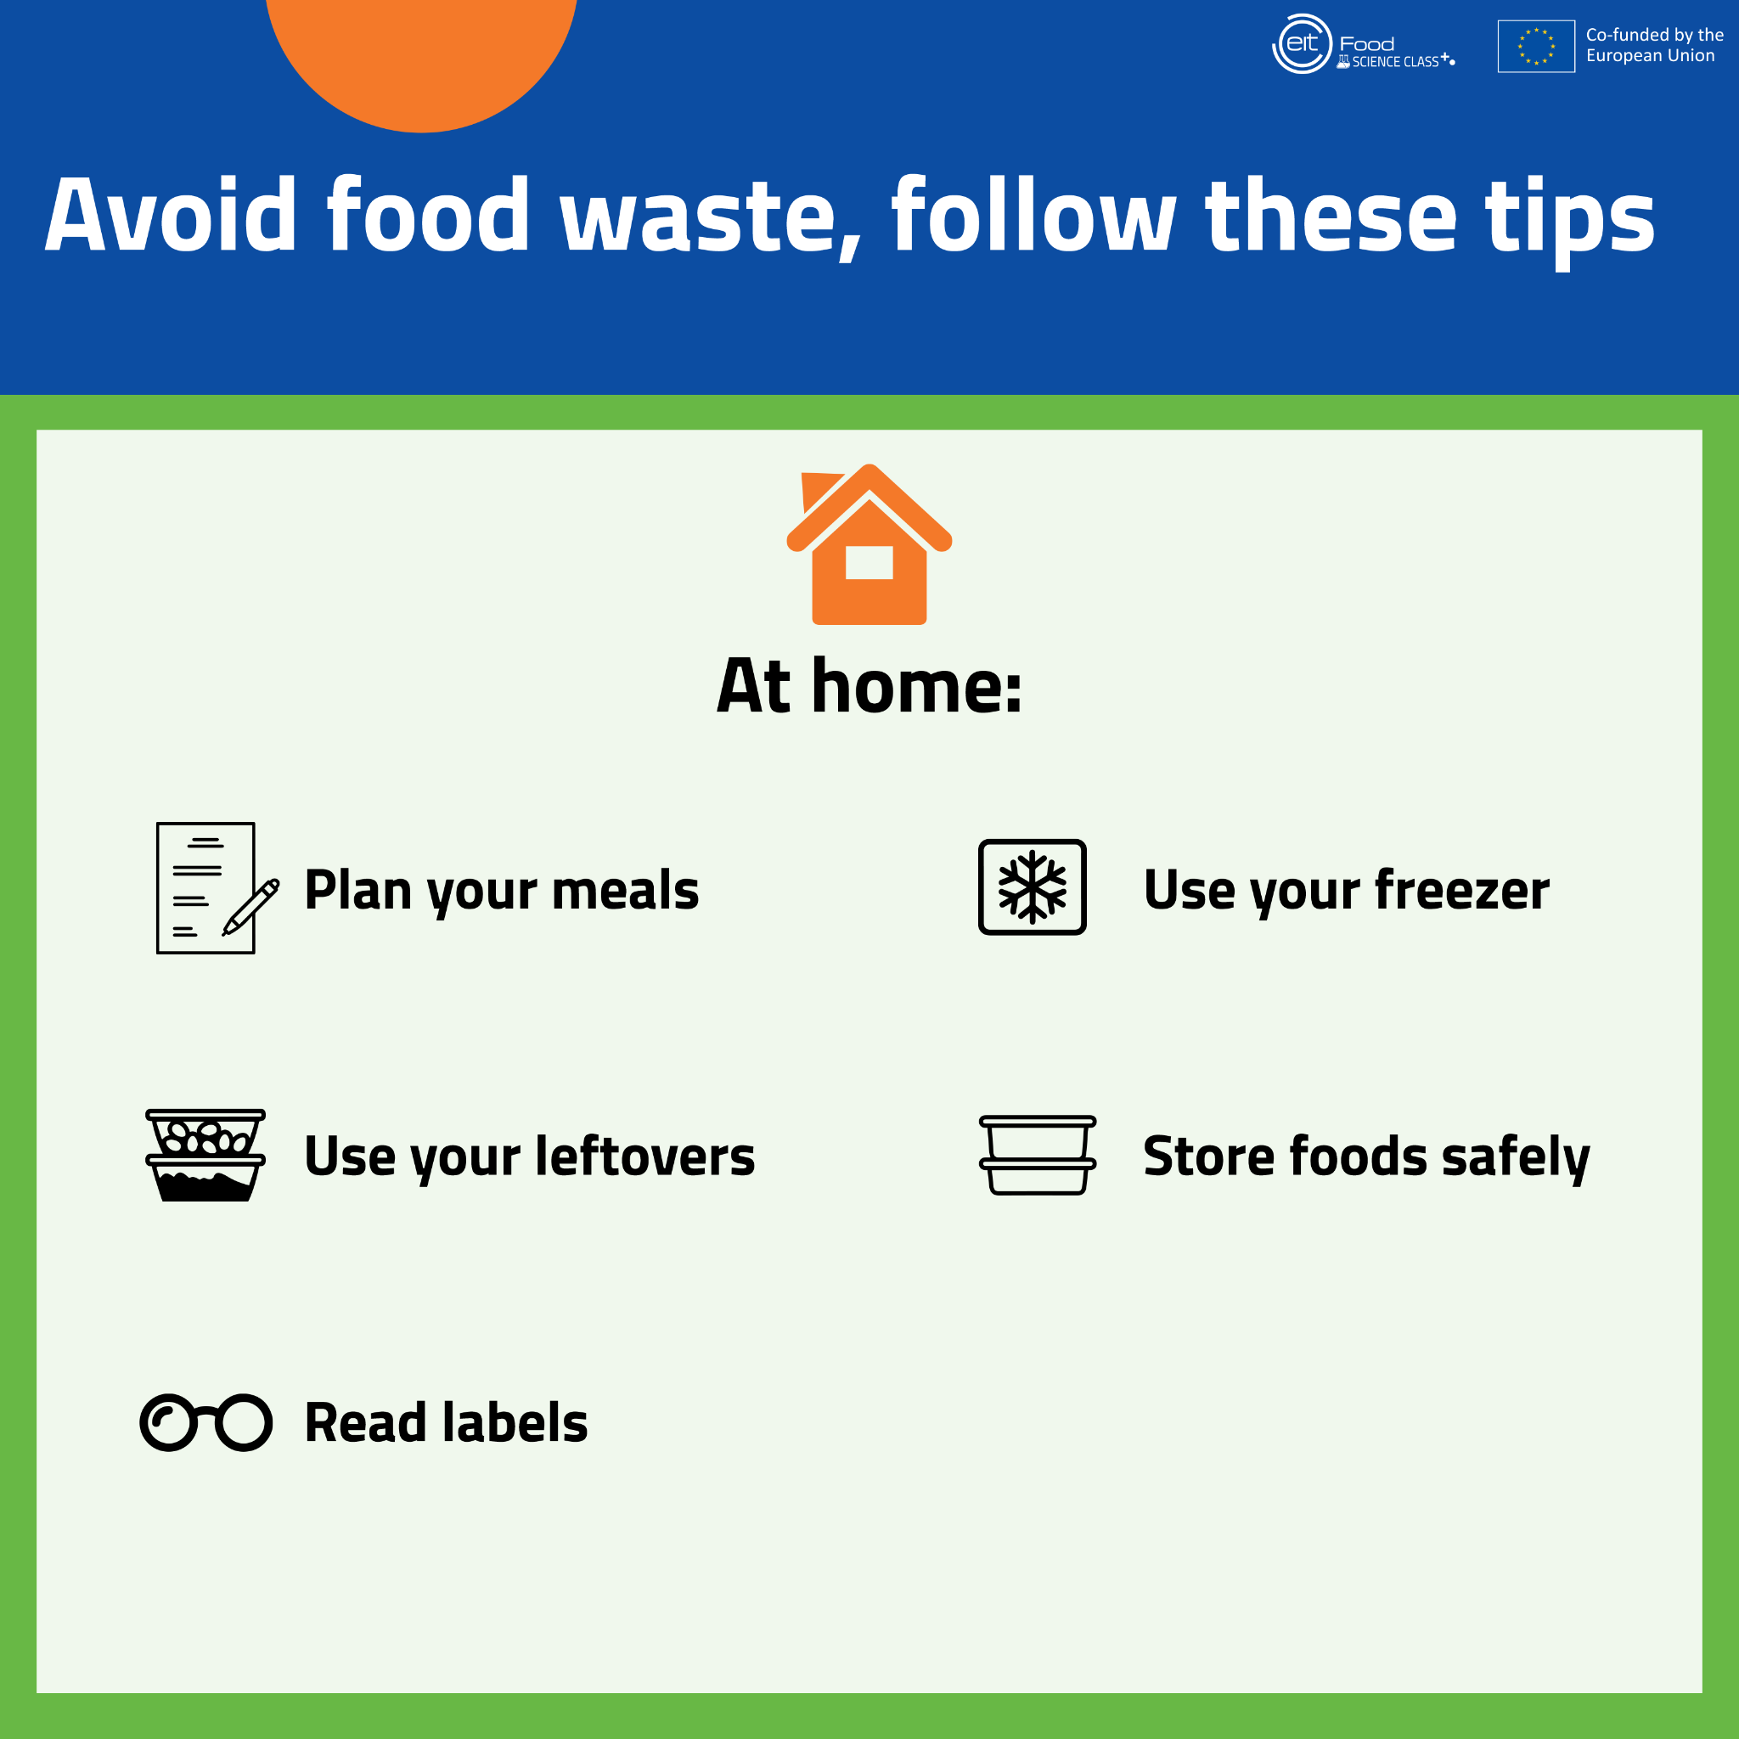
All of the above.
Around 931 million tonnes of food produced worldwide is wasted each year and most of it comes from households. We can all help reduce this problem by being careful with what we buy and how we use it.

Slide 21
5. What is the safest way to defrost meat and fish?
In the original packaging outside the fridge
On a tray in the fridge
Under cold running water
Under warm running water

Slide 22
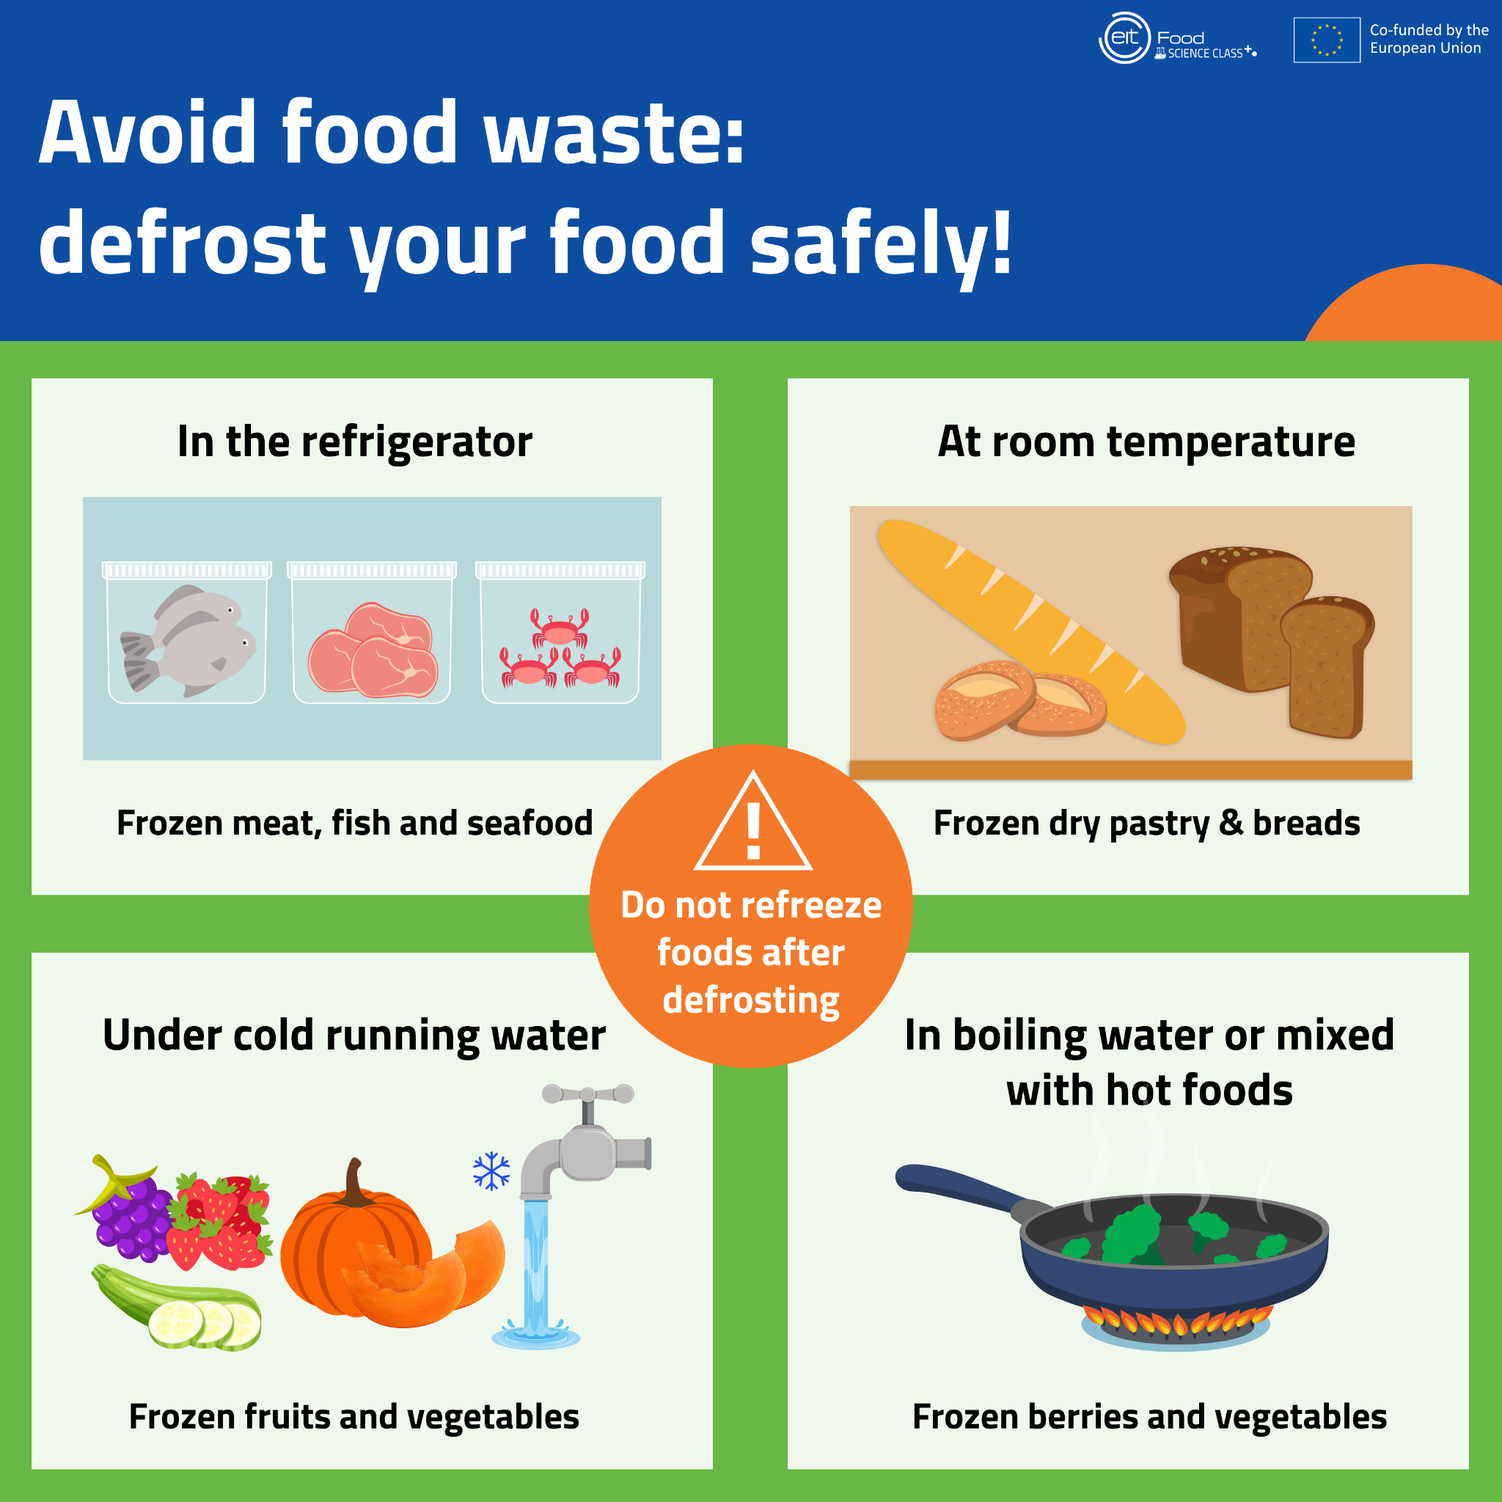
Freezing prevents harmful bacteria from growing and helps us to store foods for long periods. But low temperatures only inactivate bacteria, which will reproduce if exposed to warmer temperatures again, so make make sure to defrost foods safely.

Slide 23
6. How long can cooked rice keep in the fridge (if temperature < 5 °C)?
Up to 8 days
Up to 6 days
Up to 3 days
Up to 1 day

Slide 24
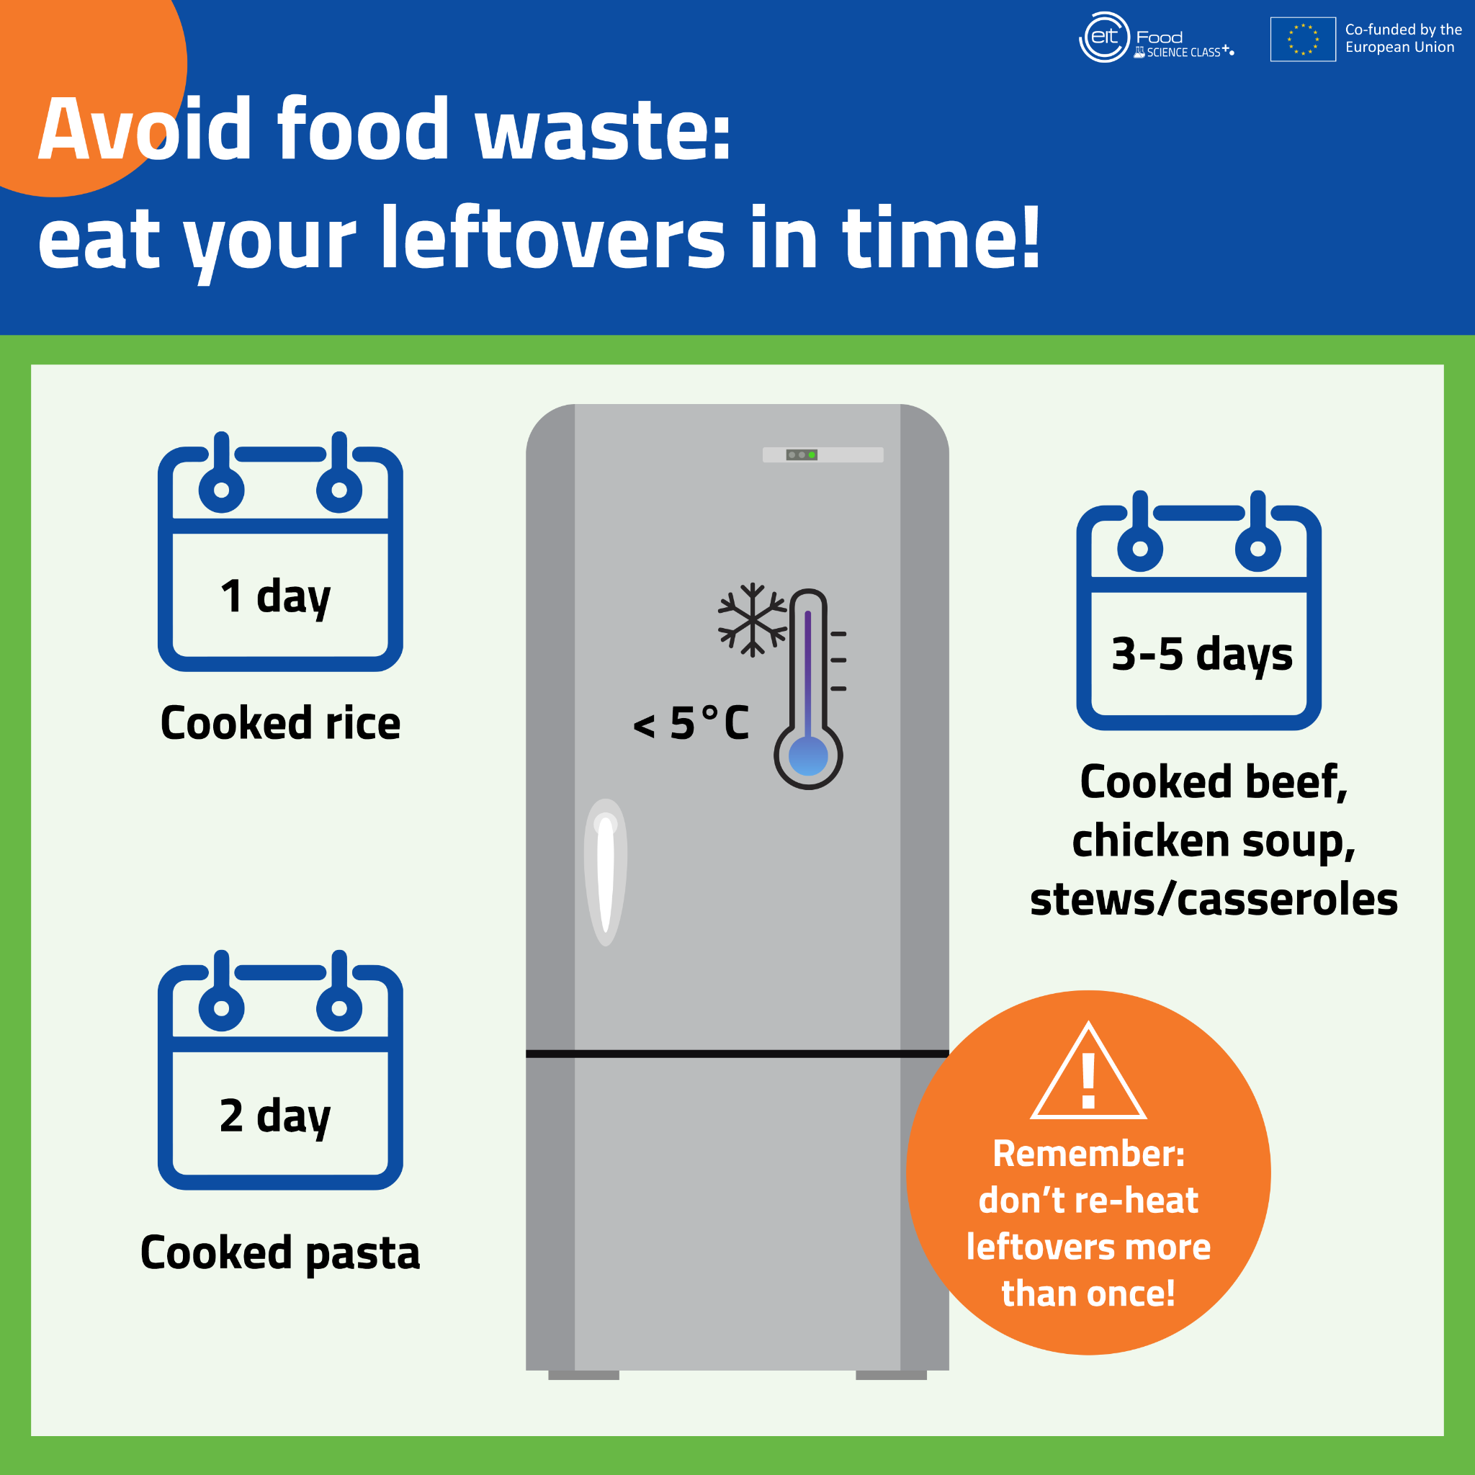
Different cooked foods last different times in the fridge. While cooked beef or chicken can be stored between 3 and 5 days, it is better to eat your pasta within 2 days and your rice the day after you cook it.

Slide 25
7. Fruits and vegetables ripen quicker if stored together with bananas.
True 2. False

Slide 26
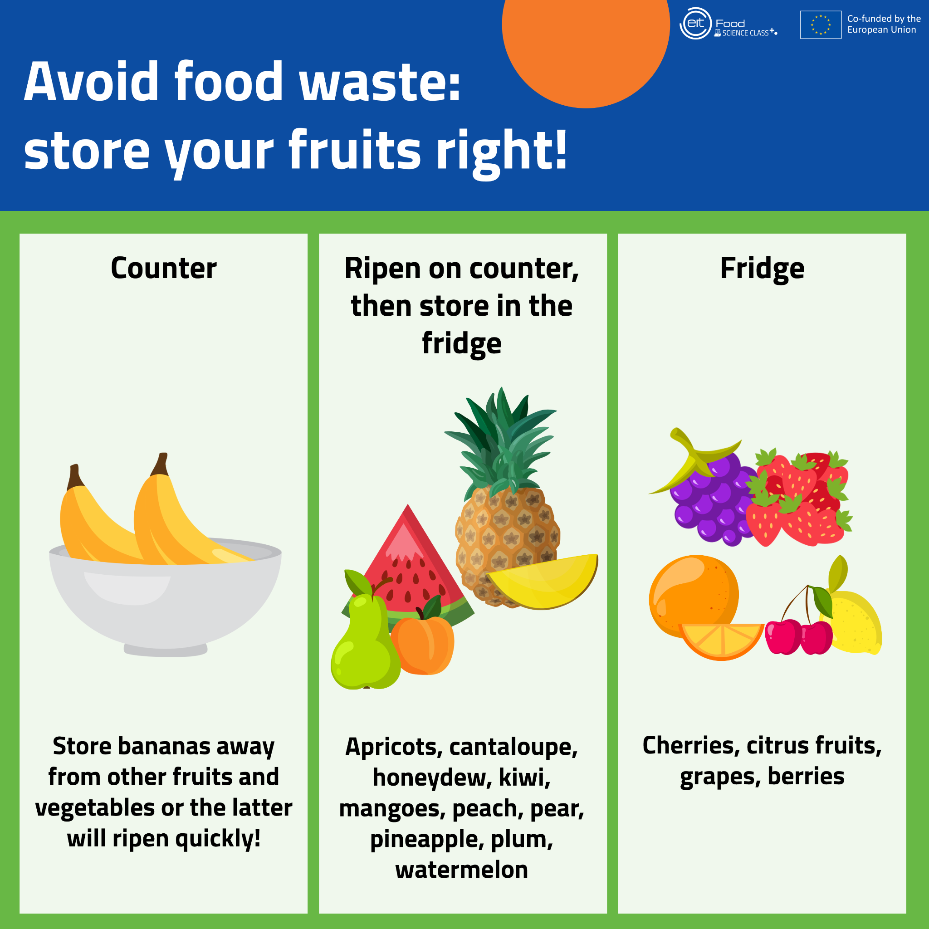
Bananas produce ethylene, a natural compound that makes fruits and vegetables ripen quicker. That’s why storing bananas together with ripe produces will make them spoil faster.

Slide 27
8. Which vegetable should be stored in the refrigerator?
Garlic
Potato
Onion
None of them

Slide 28
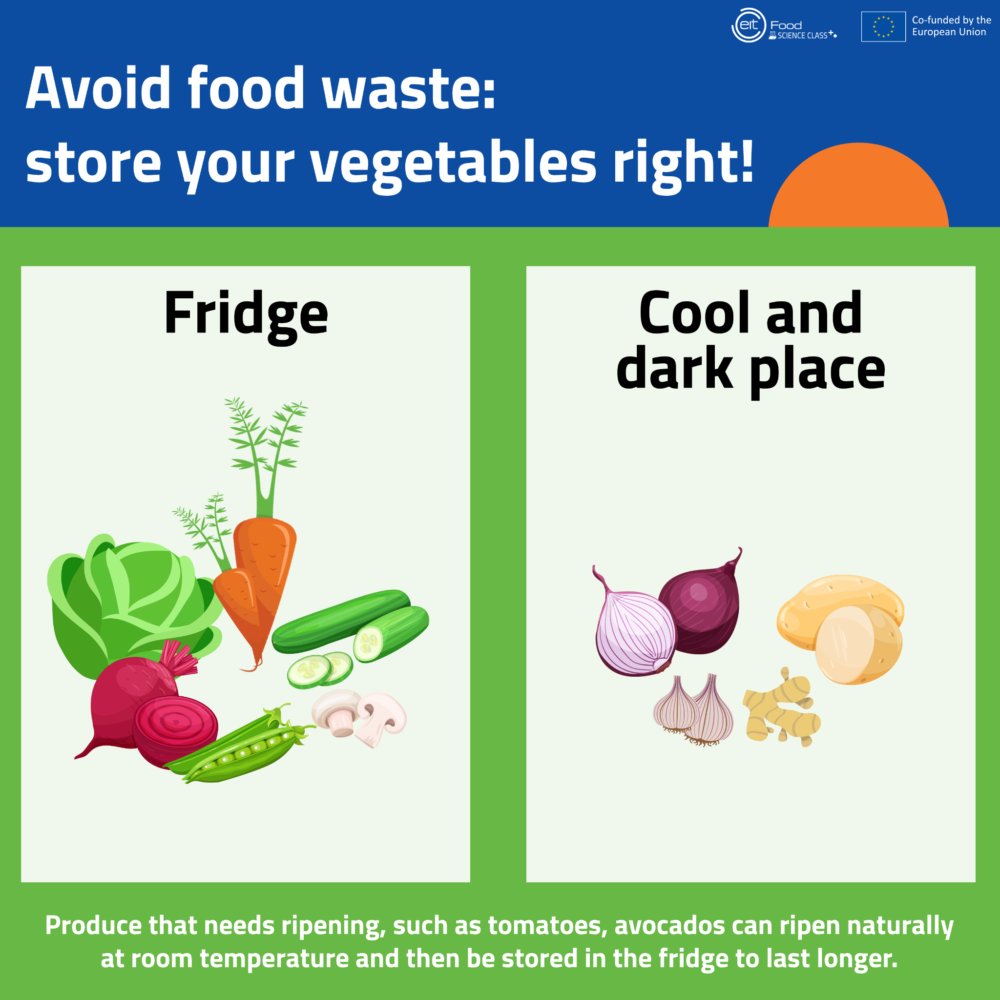
Unlike most vegetables – which should be stored in the fridge – garlic, potato, onion and other squash and root vegetables should be stored in a cool dark space (such as a cupboard or root cellar) to avoid sprouting.

Slide 29
9. Which foods cannot be eaten?
cauliflower leaves
carrot foliage
cooking liquid from chickpeas
apple seeds

Slide 30
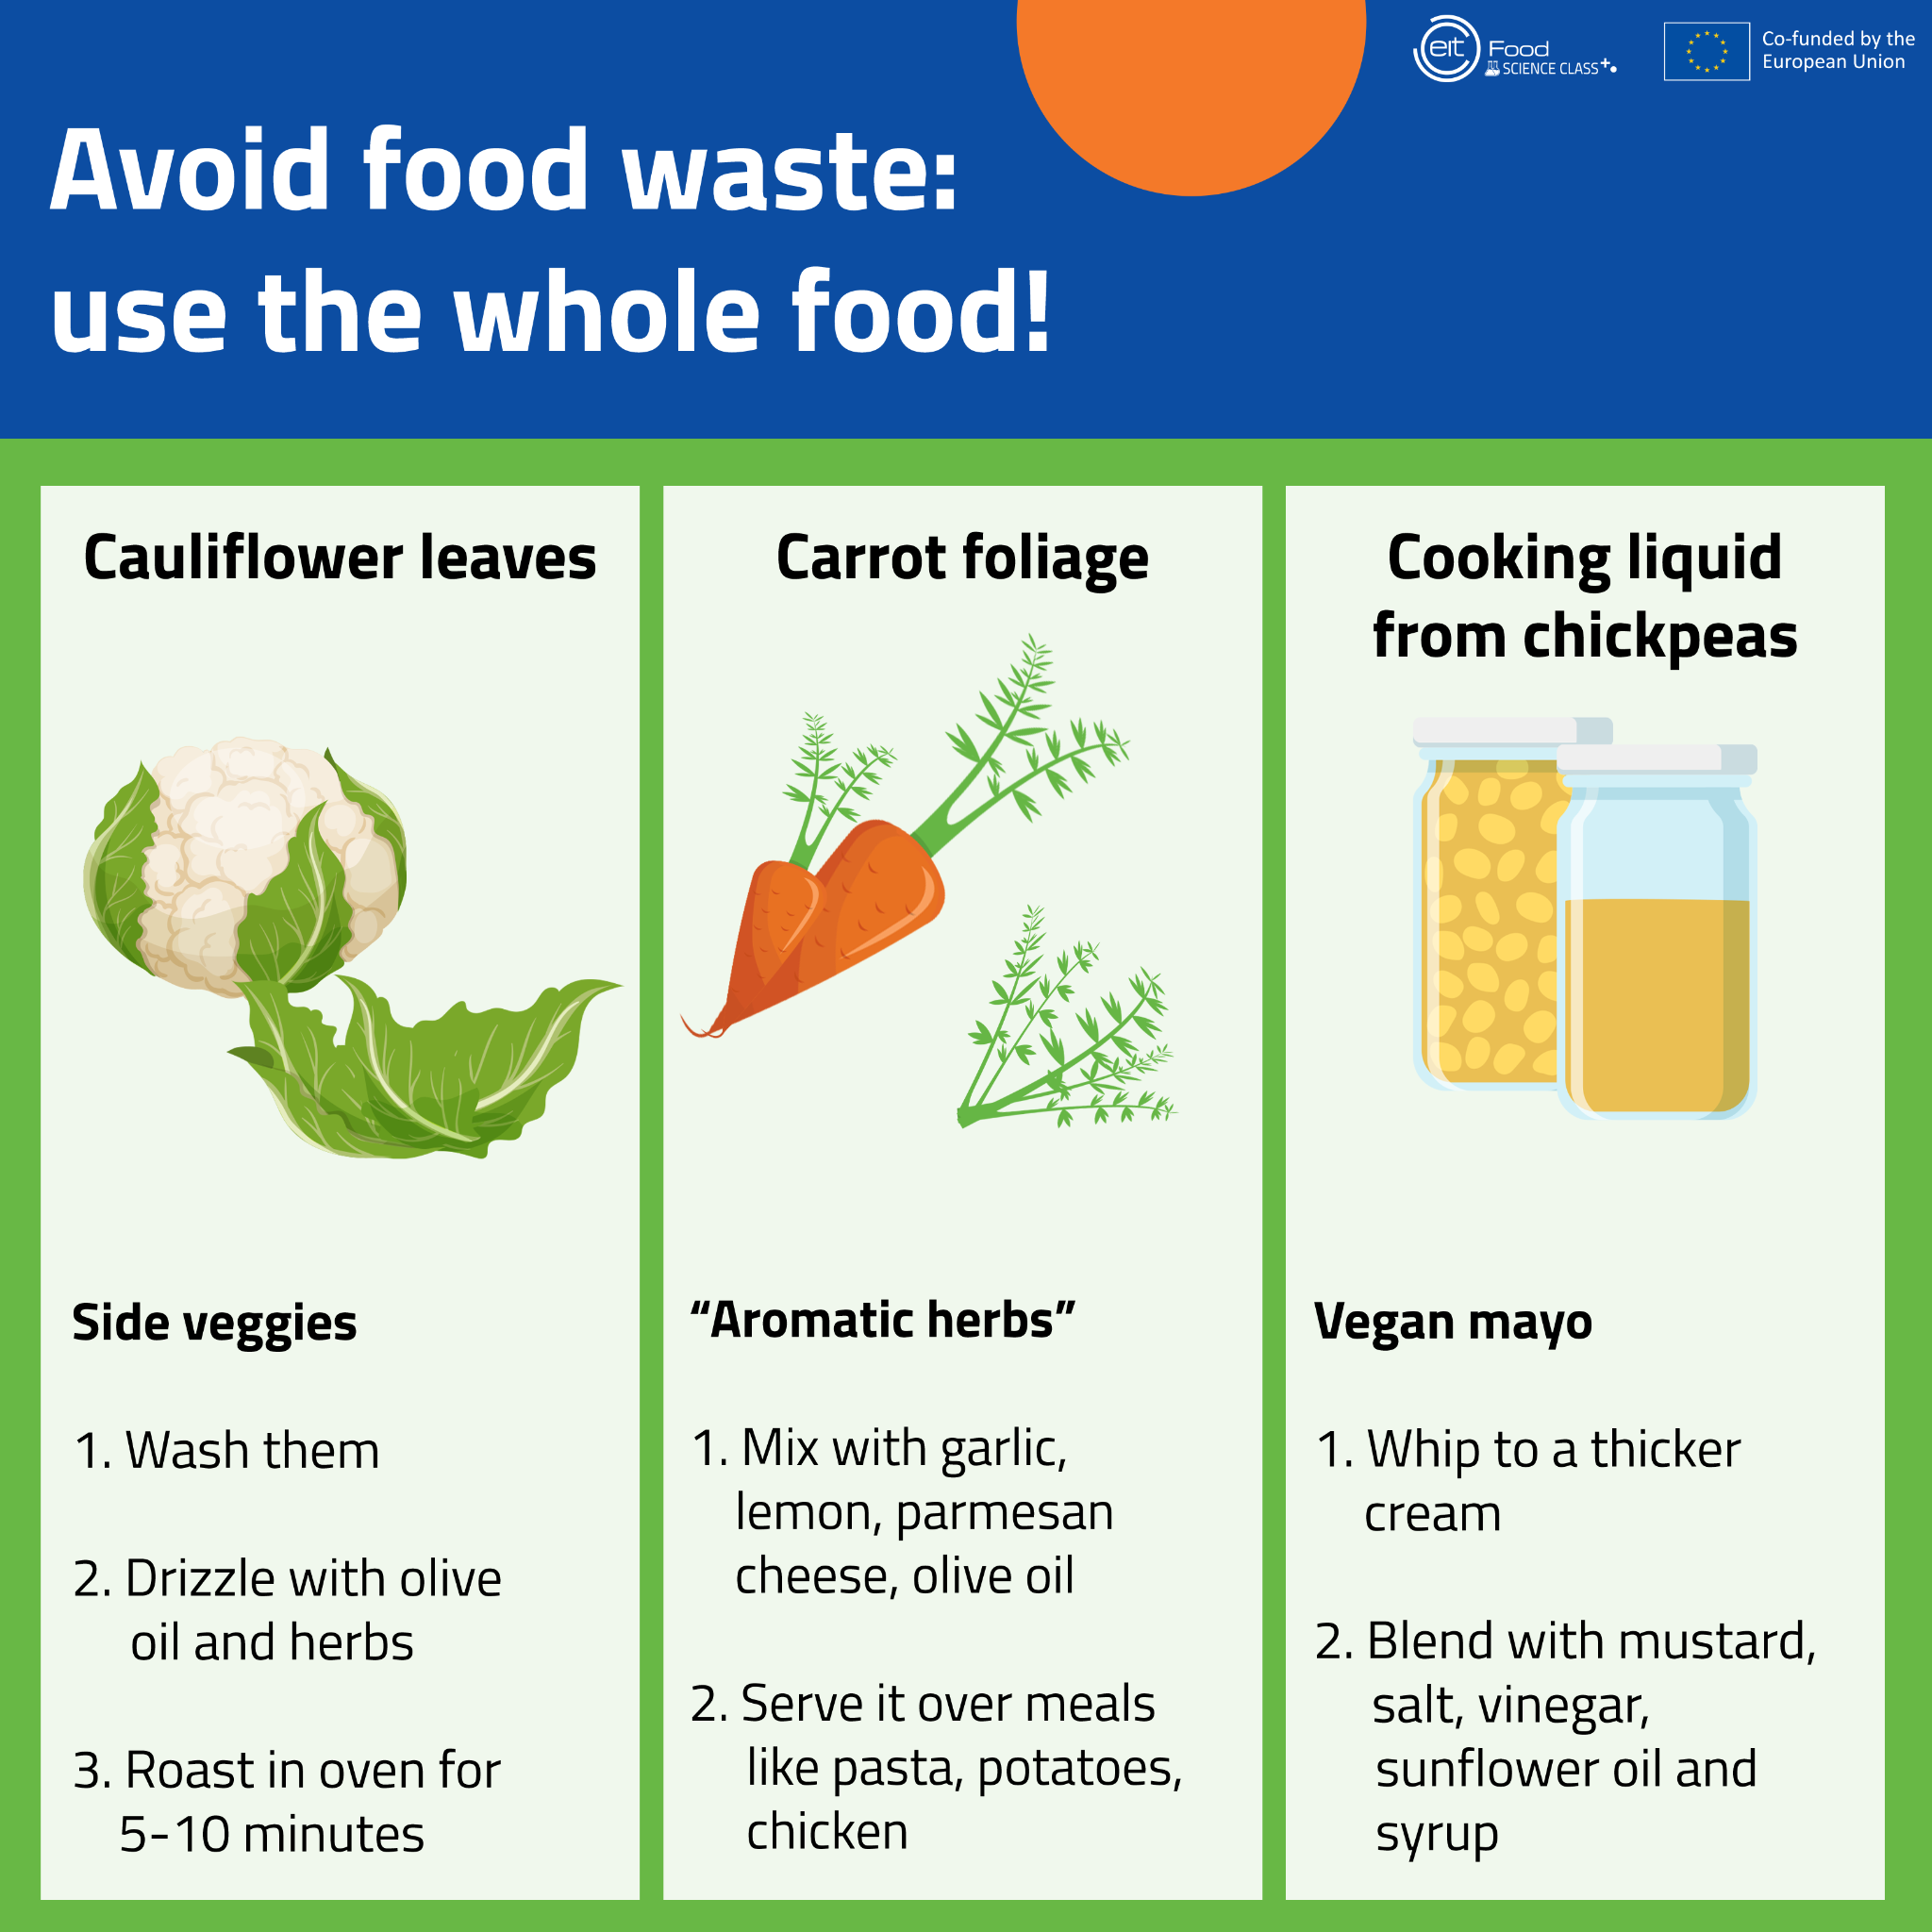
Apple seeds, as well as the seeds of pears, apricots, peaches, plums, and cherries, contain amygdalin which our bodies convert to cyanide after eating. In high amounts, cyanide can be harmful to health, which is why is better to avoid eating apple seeds.

Slide 31
10. What is the best way to store leafy greens (lettuce, parsley, etc)?
In the sealed plastic bag in which they were purchased
Washed and dried, wrapped in a damp towel in the refrigerator
In an open and ventilated container on the counter
Inside a cupboard protected from the light

Slide 32
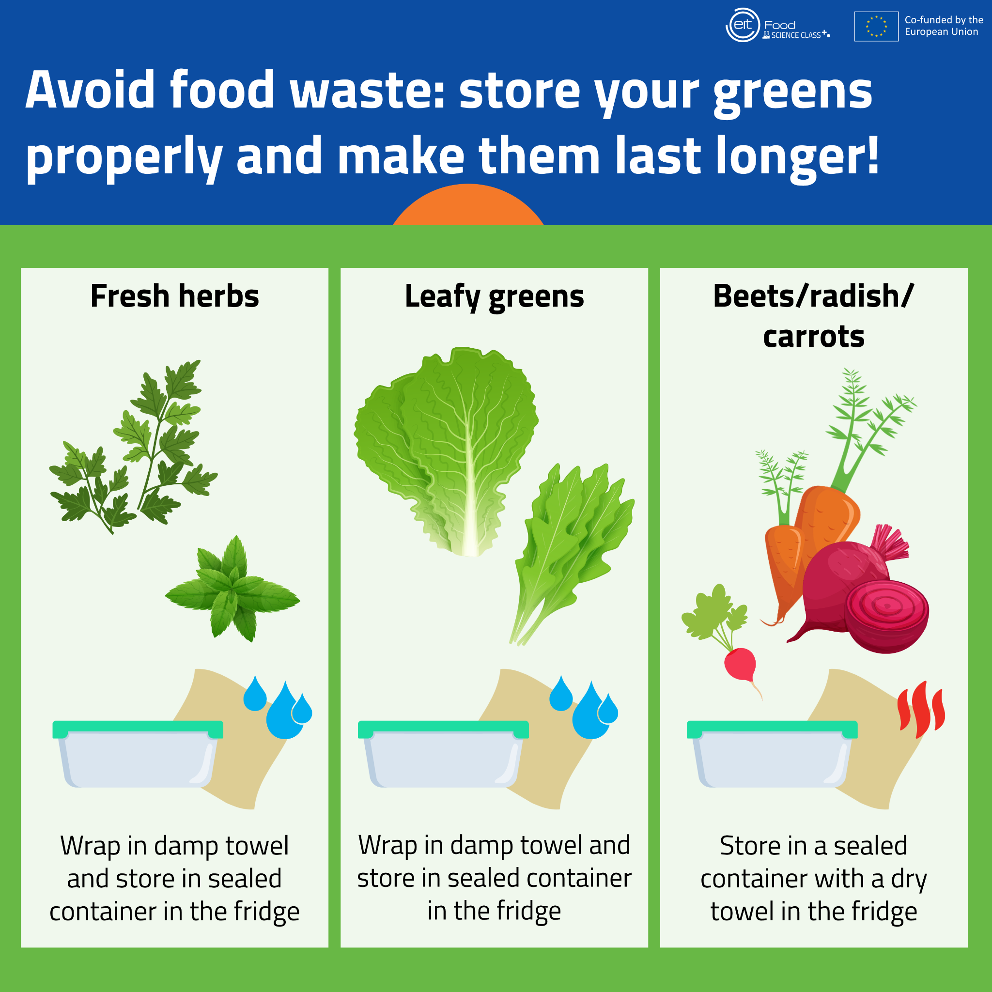
After washing and drying the leafy greens, they should be wrapped in a damp towel and stored in the refrigerator. The damp towel will help preserve the right levels of humidity which will help them last longer.

Slide 33


Slide 34
Conclusion
Food loss has economical, social and environmental consequences
Food loss happens in agriculture, management and packaging, production, distribution and consumerism
The main factor is household consumerism
There are steps that can be takes to reduce food loss (slide 20)
5 tips to reduce food waste (video)

Slide 35
Thank you!

